Slide 1
Gamma thoughts

Slide 2
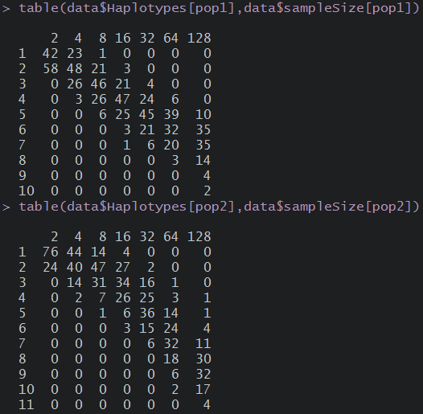
Distribution of number of haplotypes in the simulated samples
Population 1
Theta=2
Growth
Population 2
Theta=2
No Growt

Slide 3
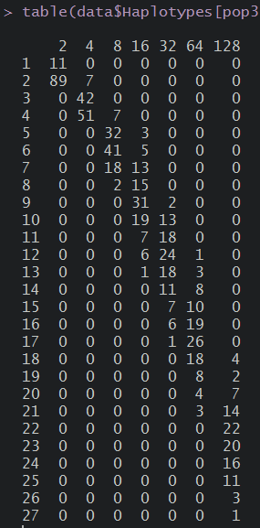
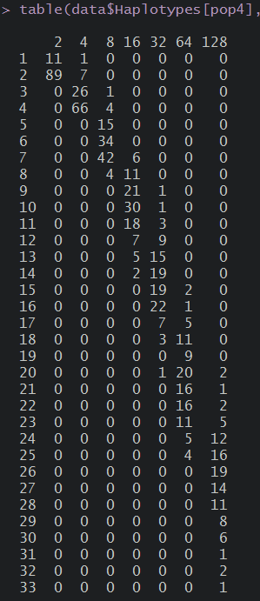
Population 3: Theta=10 Growth
Population 4: Theta=10 No Growth

Slide 6
Population 1

Slide 7
Population 2

Slide 8
Population 3

Slide 9
Population 4

